Slide 1
Aztecs (The Mexica)
Notes:
They called themselve the Mexica. But we refer to them as Aztecs

Slide 2
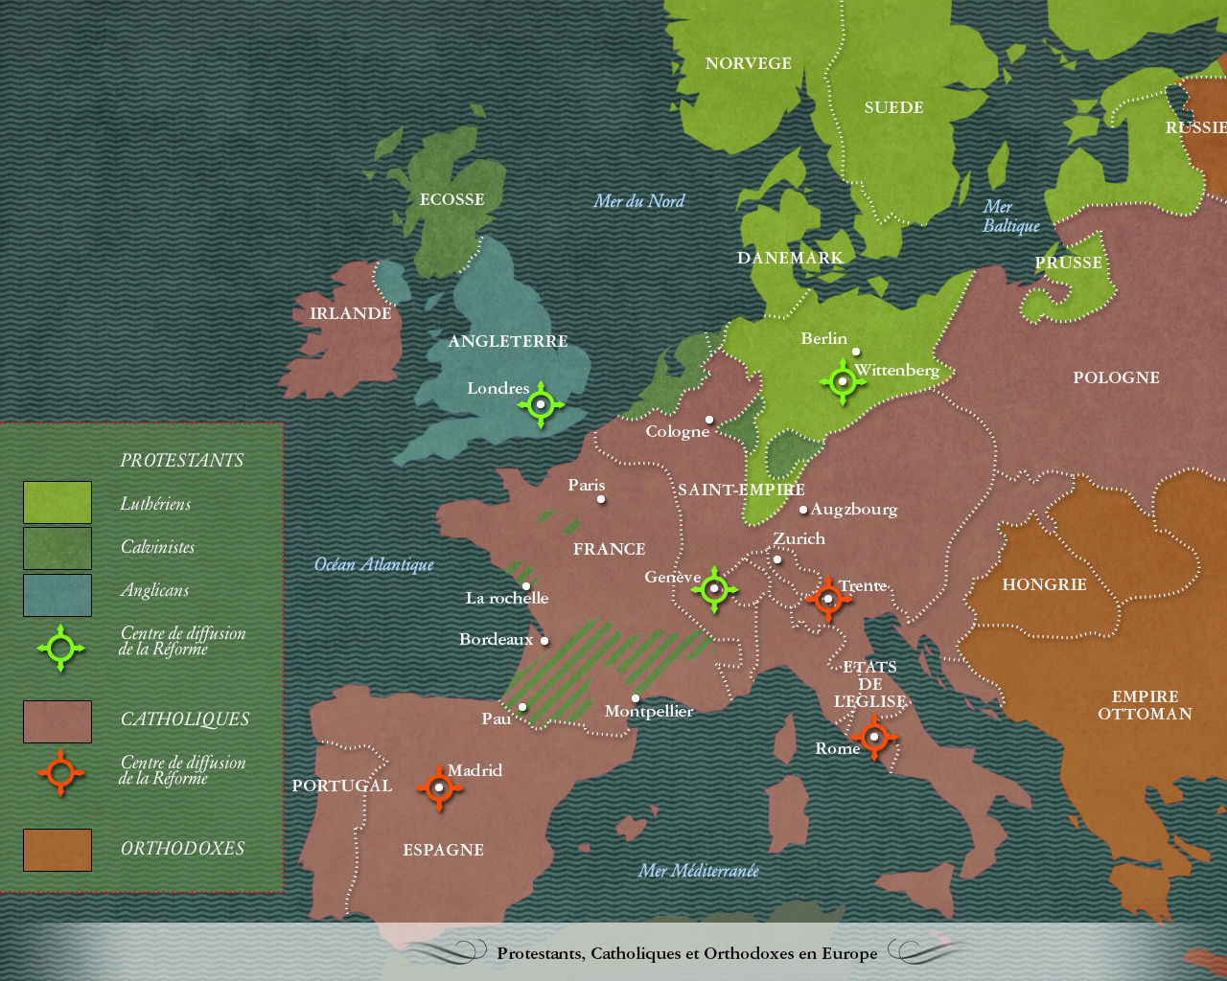
The Development of the Black Legend
Understanding the Context of 17th Century Europe

Slide 3
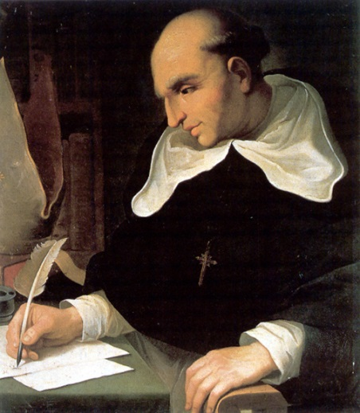
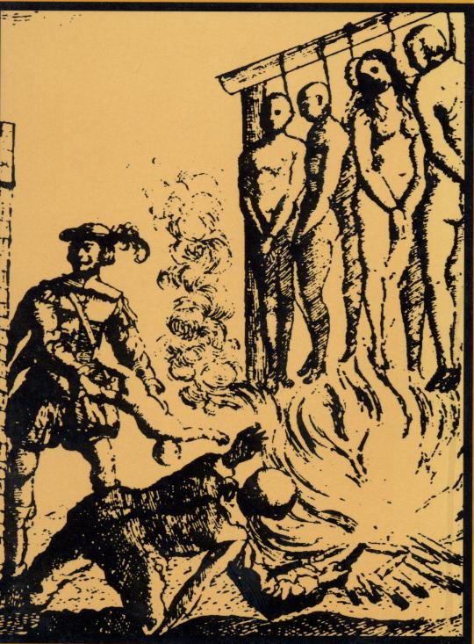
The Development of the Black Legend
Bartolome De Las Casas- Spanish land/slave owner in the island of Hispaniola
Became a friar in the Dominican order
Witnessed the atrocities committed by the Spanish on the peoples of the Americas.
Wrote A Brief Account of the Devastation of the Indies.

Slide 4
The Black Legend In Europe
Story spread quickly in Northern Europe
Why might the English Crown use it to convince Englishman to colonize North America?
Black Legend continued with the stories of Cortez and the Aztecs….

Slide 5
Goals for today
Continuing with European/Native American Clash of cultures
“The epidemic (of smallpox)decimated the Aztec Population and made it possible to triumph in their (Cortes and his men) second attempt at conquest.”
Oversimplification of the Spanish conquest of Mexico
More than the two ‘great’ men in the conflict: Montezuma and Cortes
How do we create a larger, more inclusive narrative of the European Conquest of the Americas?
Go to the primary sources
FIRST WRITING ASSIGNMENT!

Slide 6
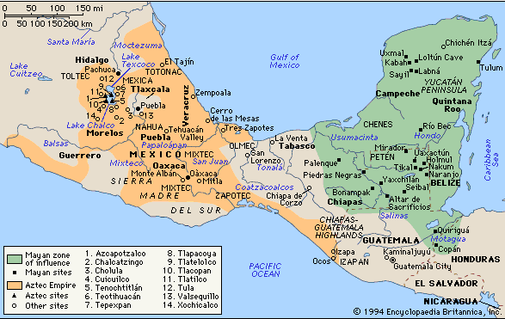
Notes:
What country are the Aztecs from?
Where are they compared to the Mayan Empire?

Slide 7
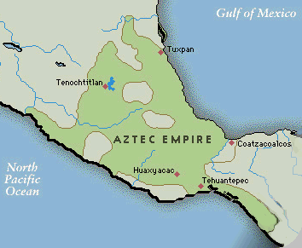
Aztec Empire
Aztecs were the last tribe in to arrive in the area (1200 BCE),
forced to live in the swamp (Lake Texcoco)
Started as Mercenaries fro the bigger tribes. Conquered Mexico in 1400
Notes:
Aztecs- a marginalized group, beat up on by the surrounding tribes. Until they became mercenaries.
Mercenaries:
-time frame of empire

Slide 8
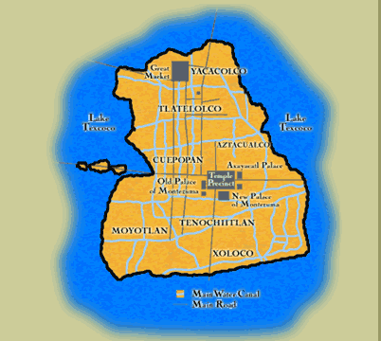
Aztec City: Tenochtitlan
An island city
Canals were used as streets and people traveled everywhere by canoe
Grid city
Buildings commonly found:
Gardens, Fountains
The Royal Zoo
A market that could hold 25,000
Medical system
Mandatory schooling for all male children
Notes:
Grid City: having a grid based system is very advanced. Did not have these cities in Europe. Paris would eventually tear down a large part of their city to create his

Slide 9
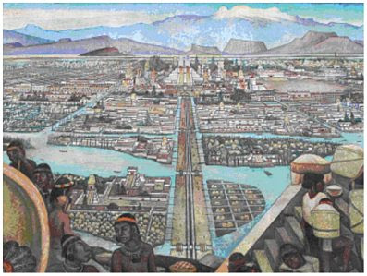
And since we saw so many inhabited cities and towns on the water, and on solid ground other large towns, and that causeway so straight and leveled that went to Mexico-Tenochtitlan, we were wonder-stricken, and we said to each other that it all seemed like the enchantment tales of the Amadís book, for the great towers and cúes [temples] and edifices, that they have inside the water, and all of them the product of masonry work, and still some of our soldiers said if all of what they saw was dreamlike.
Notes:
Bernal Diaz quote 2- And since we saw so many inhabited cities and towns on the water, and on solid ground other large towns, and that causeway so straight and leveled that went to Mexico-Tenochtitlan, we were wonder-stricken, and we said to each other that it all seemed like the enchantment tales of the Amadís book, for the great towers and cúes [temples] and edifices, that they have inside the water, and all of them the product of masonry work, and still some of our soldiers said if all of what they saw was dreamlike.

Slide 10
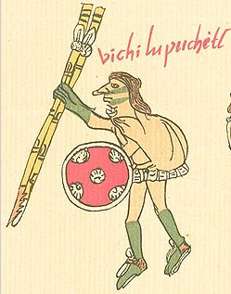
Aztec Religion
Main God: Quetzalcoatl
Sun god: Huitzilopochtli
Made the sun rise every day
When the sun set, he had to fight a battle with evil to get the sun rise the next day
He drew strength from human blood
Human sacrifices to keep him pleased
Notes:
Over 1000 gods
Quetzalcoatl was the major god. Appeared in many forms: god of learning, death, wind, birth. Appeared as an old man, a serpent, and in many other forms

Slide 11
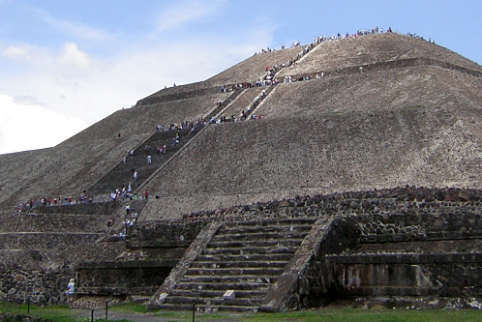
Human Sacrifice in Aztec Society
Records that they sacrificed 20,000 people in one day for the Sun temple
Why did they Sacrifice?
Notes:
October 2012- Archeologists found a mass grave of 50 skulls, part of a large ritual sacrifice
This recent discovery is more about political theatre. Mass sacrifices of men and women captives of war, demonstrate the Mexica’s dominance in the region, dissuade conquered peoples from rebelling. It is estimated that
-But also about the intersection between religion and war

Slide 12
Traditional Theory: Political Theatre
Why did they Sacrifice?
-Historians used to believe that Aztecs sacrificed to scare the people they conquered
-Theory rooted in the traditional Spanish belief that the Aztecs were ‘evil’

Slide 13
New Theory: War Paradigm
Aztecs did not sacrifice to scare and control the people they conquered
Instead they conquered people so they could commit human sacrifices
To understand, why we have to understand Aztec view of war and the world

Slide 14
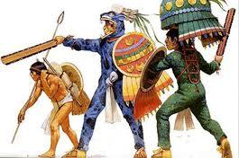
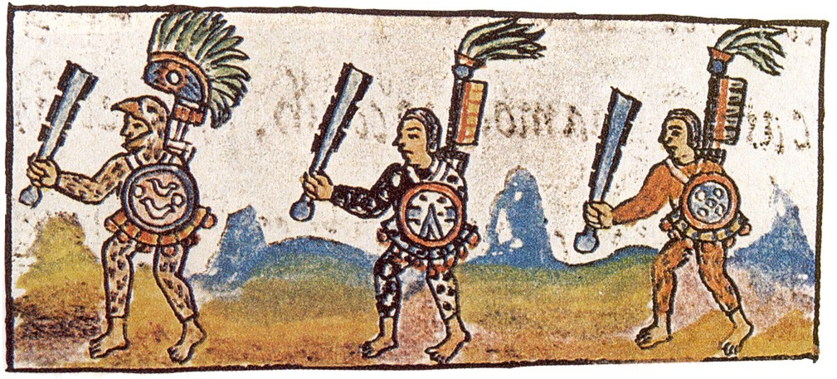
War DEFINED Aztec Life
Any man was allowed to be a warrior if he could fight
Warrior=ultimate sign of masculinity.
Each man had to collect his own captives. If you helped your friend you would be killed.
Your ranking in society increased with number of captives you had

Slide 15
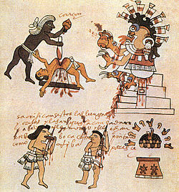
Sacrifice Imitated Battle
The battleground was a way of worshipping, so worshipping imitated the battleground
Captives were required to engage in a fake battle, stabbed, heart and limbs removed. Warrior and nobles would eat parts of the body
Notes:
This process was not necessarily unwanted by the captives. It was a common belief in Aztec culture that eventually every good warrior would become a captive. It was a cyclical process. The warriors would eat some of their captives and would wear their captives skin to show that one day they would become the captive.

Slide 16
Paradigms
Paradigm= A framework or a group that theories that help us understand Society and the way the world works.
Aztec= The War Paradigm
American Society= What is our paradigm?

Slide 17
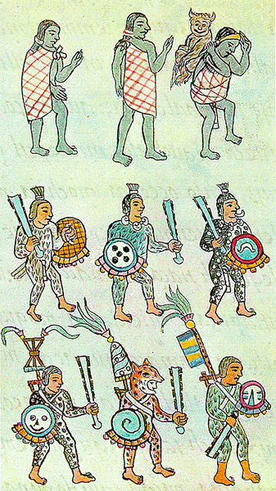
Life = War
Women went to war when giving birth. Childbirth was considered their battleground.
Women also went to war with dirt in their houses
Notes:
Aztec’s operated on a war paradigm.
-how did this paradigm develop?—Aztec society started as mercenaries!
-what are some of the paradigms that shape our understanding of the world?

Slide 18
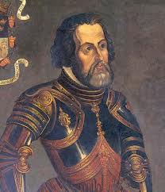
The Spanish Conquistadors
An Explorer from Spain that wanted to discover and conquer parts of the New World
Hernan Cortes: Expedition into Mexico
Arrived in the outskirts of the Aztec Empire
Gained allies with certain tribes
Defeated the Aztec Emperor Montezuma
Colony of New Spain

Slide 19
BATTLE OF CHOLULA
BATTLE CHOLCULA
PRIMARY SOURCE ACTIVITY

