Slide 1
Iroquois in American History
Invited to the Albany Congress and provided inspiration for the Albany Plan
Invited to The First Continental Congress
Gave Hancock an Iroquois name
Encouraged independence and suggested a peace between the English and the Iroquois
One of the many influences on the creation of the constitution
Are they the oldest democracy still in existence today?

Slide 2
English Migration in the America’s
Using multiple primary and secondary sources to create a larger understanding of the early Colonial American narrative
Macro Level vs. Micro Level

Slide 3
Incentives for Colonization on a Macro Level
Economic and Nationalistic

Slide 4
Our Economic System Today
What is it called?
How does it operate?
What values does it rely on?

Slide 5
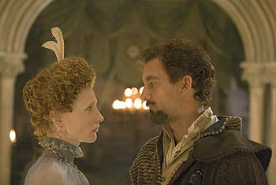
What Economic Issues Faced England?
European Wars and Competition
Spanish Empire in Full Swing (1492→)
Gold and Silver provide power for Spain
English lack resources- trade
Early colonies are for piracy and find gold
Destruction of Spanish Armada shifts balance in favor of England (1588)

Slide 6
Mercantilism: Main Goals
Encourage growth of native merchant ships, this included the colonial ships.
Protect English manufacturers from foreign competition.
Increase the wealth of a nation (i.e. accumulate as much hard money as possible—colonial money was worthless in England; merchants wanted gold) and to become the wealthiest/most powerful nation.
Become self-sufficient

Slide 7
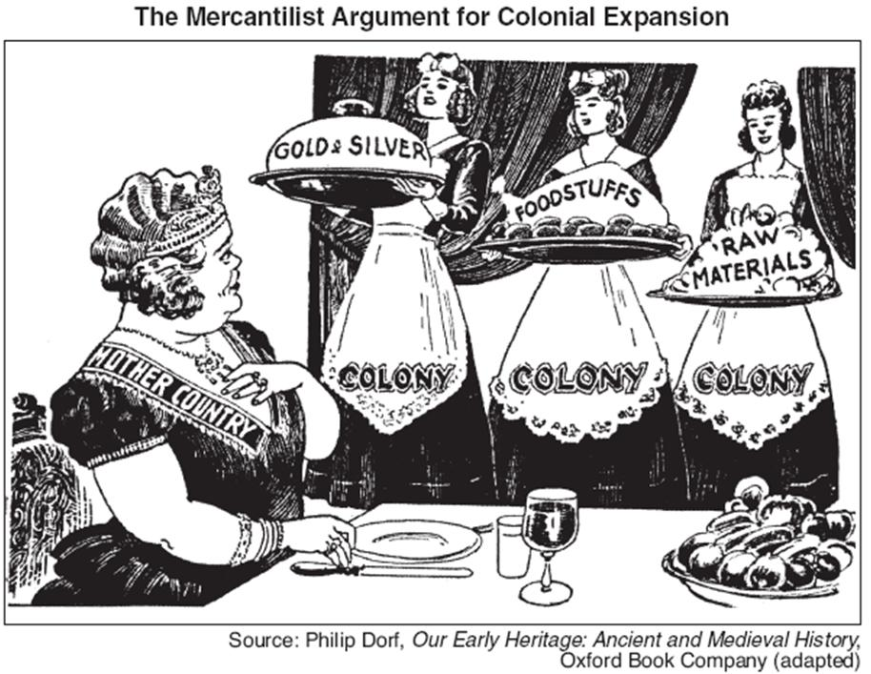

Slide 8
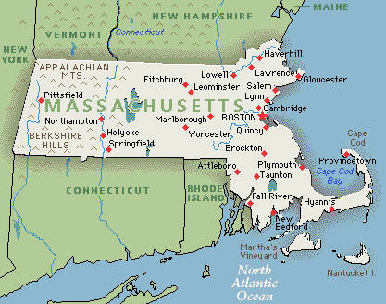
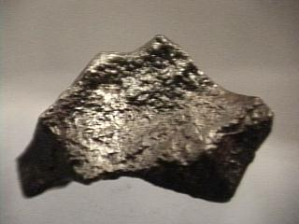
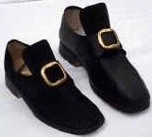
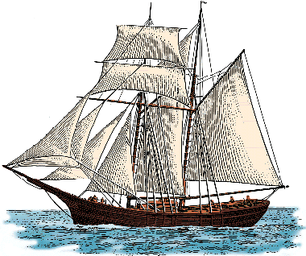
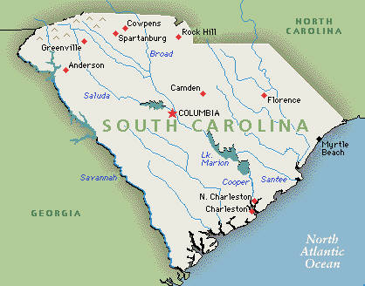
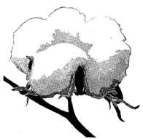
MERCANTILISM
TIMBER
RESOURCES
IRON
COLONIES
$$$
FISH
MANUFACTURED GOODS
ENGLAND
INDIGO
RESOURCES
RICE
COTTON

Slide 9
The Values of Mercantilism
Enhance National Strength,
Provide Self-Sufficiency,
and Create and Pay For Military Power
From the British Perspective:
“A Rising Tide Raises All Boats”
“What Is Good For The Empire
Is Good for All Its Parts”
And it is how everyone does economics

Slide 10
Colonization on an Individual Level (Micro)
Migration (Emigration, Immigration)
Pull Factor
Push Factor

Slide 11
Primary & Secondary Sources for Padlet Corkboard
Headright Systems
Salutary Neglect
John Winthrop
Richard Haklyut
English Wage Chart
Sample: http://padlet.com/wall/hi6flxt27y

Slide 12
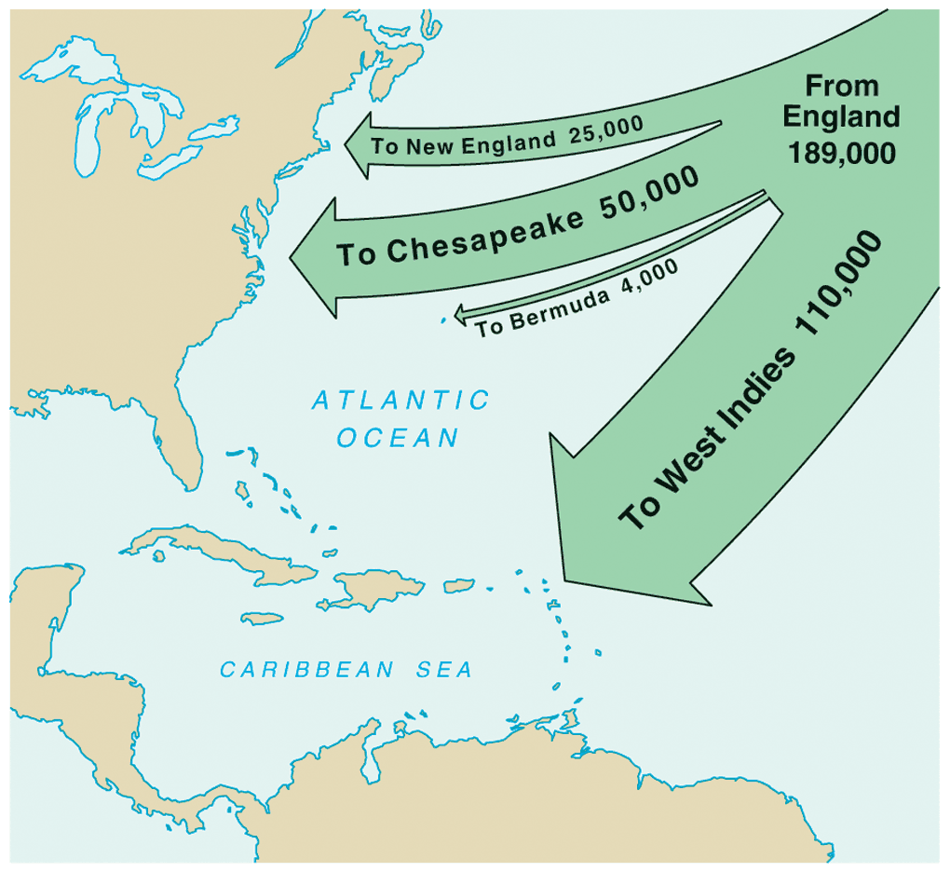

Slide 13
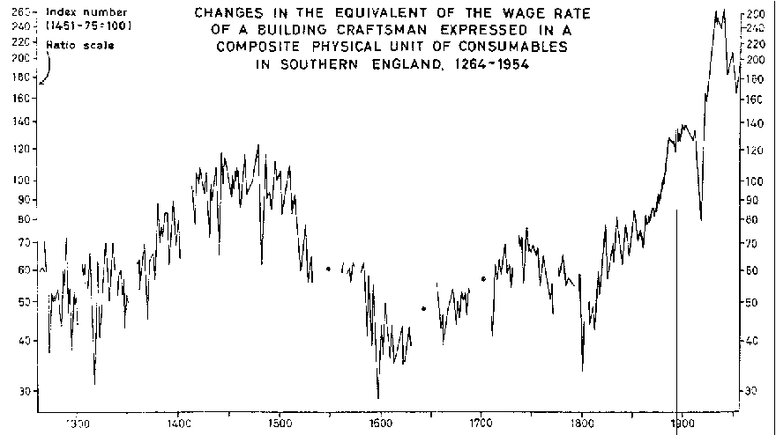

Slide 14
Homework
Introduction to American Colonies by Alan Taylor
Practice Active reading- Highlighting
3 Main Terms
2 Themes
1 Essential Question

