Slide 1
History Textbooks, The Native Americans and Christopher Columbus

Slide 2
Textbooks and History
Take out your answers to last nights questions
"[T]he teaching of history, more than any other discipline, is dominated by textbooks. And. . . textbooks are boring. The stories that history textbooks tell are predictable, every problem has already been solved or is about to be solved. Textbooks exclude conflict or real suspense.”
Do you agree or disagree with this quote? How do your answers to last night questions relate to this quote?
Use the textbook reading from last night to either support this quote or disagree with it.

Slide 3
Columbus & Conquest
"Heroification is a degenerative process (much like calcification) that makes people over into heroes. Through this process, our educational media turn flesh-and-blood individuals into pious, perfect creatures without conflicts, pain, credibility, or human interest."

Slide 4
What was the Age of Exploration?
When the Ottoman Empire took control of Constantinople in 1453, it blocked European access to the area, severely limiting trade.
Searching a new way to obtain spices and silk
European improvements in map building, shipbuilding and navigation
Portugal: Bartolomeu Diaz, Vasca de Gama
Spain: Funded Christopher Columbus (Italian)

Slide 5
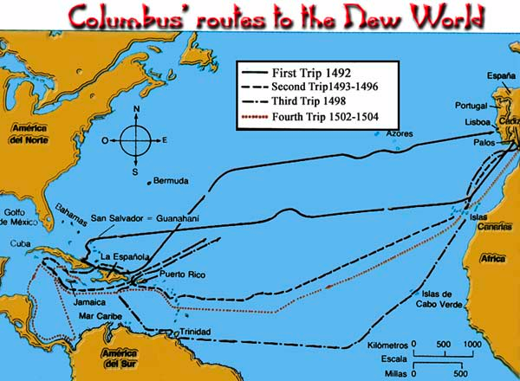
In 1492..Columbus sailed the ocean blue

Slide 6
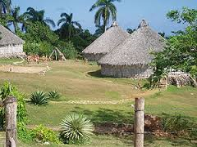
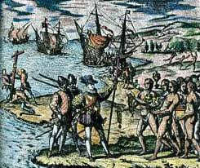
Taino, Carib and Arawak People
Flourishing small village culture
Fishing, agriculture
Less centralized, more matrilineal
Very little warfare
By 1512, nearly 95% of these tribes were wiped out

Slide 7
Is Columbus a Hero?
Three short articles with different opinions
While reading, fill out table below
Arguments for | Arguments Against

Slide 8
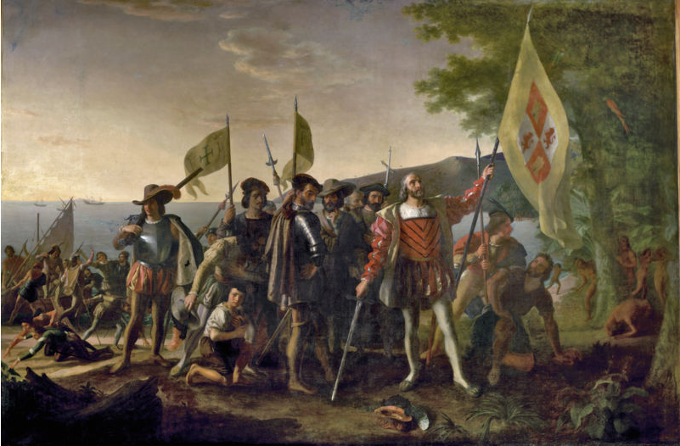
Is Columbus a Hero? – Open Letter

Slide 9
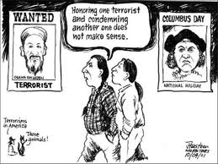
Political Cartoon: Present Day
“Christopher Columbus”
Andy Razaf and Leon Brown Berry

Slide 10
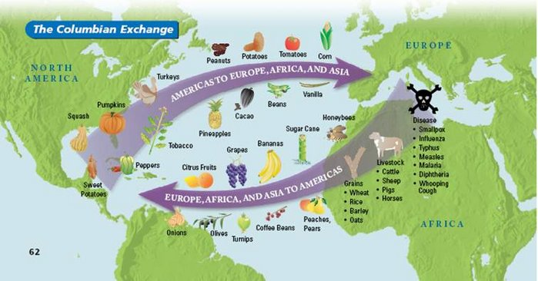
The Columbian Exchange
The exchange of goods between the Old World and the New World
The Advantages and Disadvantages: Crash Course!

Slide 11
Homework
Brinkley 10-18
Reading Questions: on the weebly website

